Slide 1
DSAI Mini Project
By: Liew Zhi Li (Sherna), Ooi Min Hui, Tan Wei Ren Ezekiel
Lab Group: FS3

Slide 2
Our problem - Happiness
Happiness is something that everyone desires and chases after
Can we predict happiness?
Notes:
Our group chose to use the World Happiness Records dataset. Happiness is something that everyone desires and chases after. For example, many people want to migrate to happier countries to live happier lives. So, our group chose to tackle the problem - can we predict happiness?

Slide 3
Can we predict happiness?
What is the most significant variable used in predicting happiness?
Linear Regression - Multi-variate and Uni-variate
How accurately can we predict happiness?
Neural network
Notes:
We made use of a 2 pronged method to approach the problem. First, we made use of multi-variate and uni-variate linear regression to find the most significant variable used in predicting happiness scores. Second, we made use of a neural network to predict happiness scores, to find out how accurately we can predict happiness.

Slide 4
Work Allocation
Cleaning of data done by: Sherna and Ezekiel
Data visualization done by: Min Hui
Linear Regression
Multi-variate done by: Min Hui
Uni-Variate done by: Sherna
Neural Network done by: Ezekiel
Compilation done by: Ezekiel
Conclusion from our analysis

Slide 5
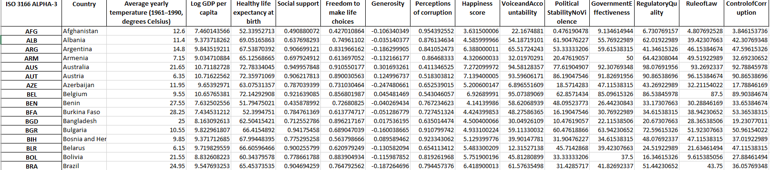
Data Cleaning
Combine data into one excel sheet
World Happiness report
External data on governance and temperature
ISO-3166 codes as index (SIN, MYS, THA)
Correct for differing country names across datasets (East Timor -> Timor-Leste)
Correct for wrong ISO codes
Remove all countries with NULL values,
Notes:
We made use of 2 external sources of data in our analysis as well, one on governance factors as majority of the WHR factors are government controlled and one on temperature as we have found evidence supporting the fact that temperature is related to happiness scores. We also added country codes as index for identification of countries. There were also a few different country names across datasets which had to be corrected. Also, some countries did not have data and had NULL values instead which had to be removed.

Slide 6
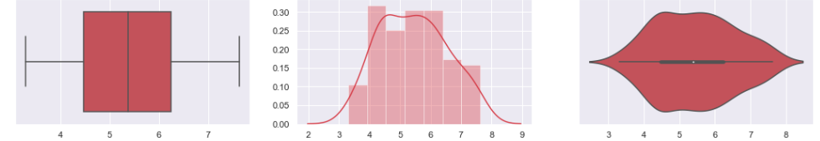
Data visualization
Box plots, Histogram (with KDE) and Violin plot of 14 variables to show their distributions
13 independent variables (6 from WHR, 7 from external sources)
1 dependent variable (Happiness)
Happiness Scores
Notes:
Summary of all variables employed in analysis of data.
We plotted box plots, histograms and violin plots of the 14 different variables to show their individual distributions. For example, this are the plots for the happiness scores

Slide 7
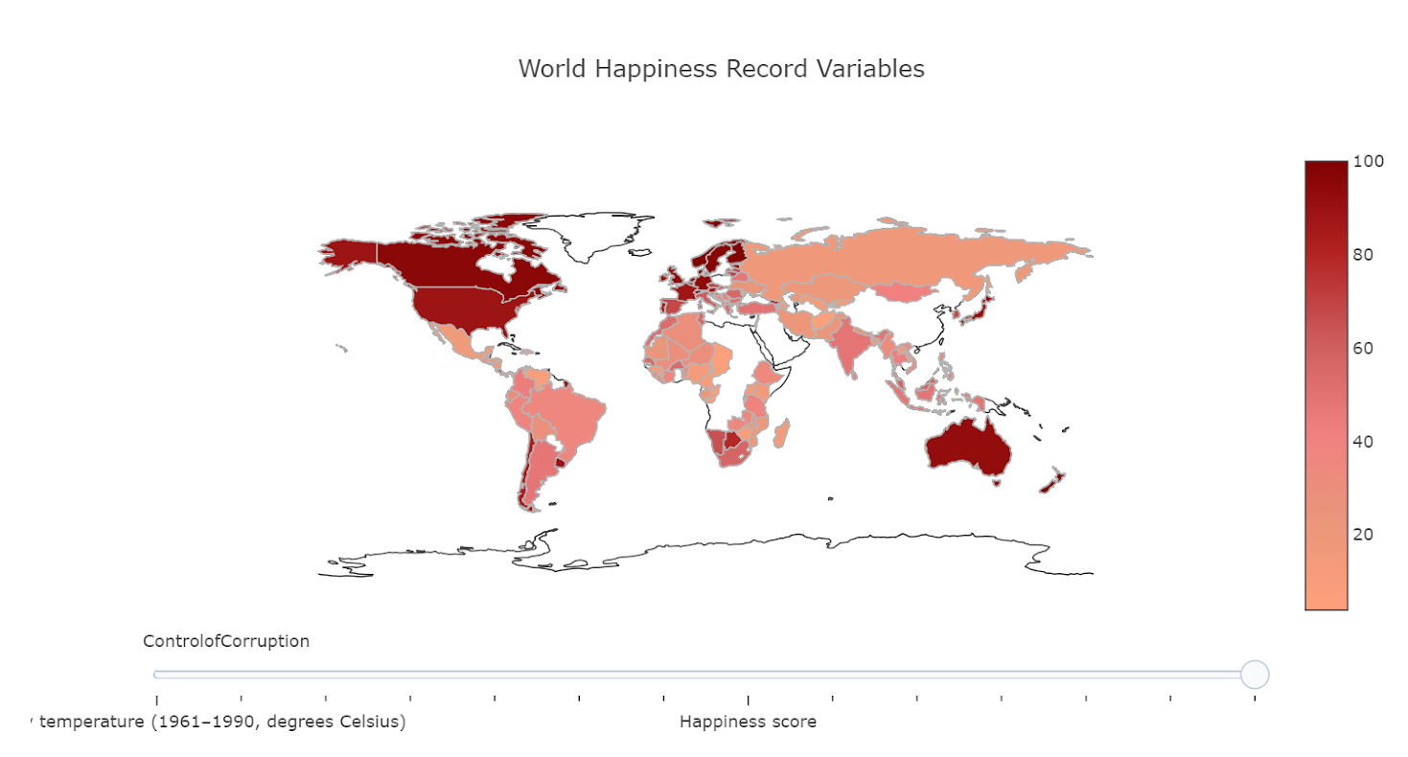
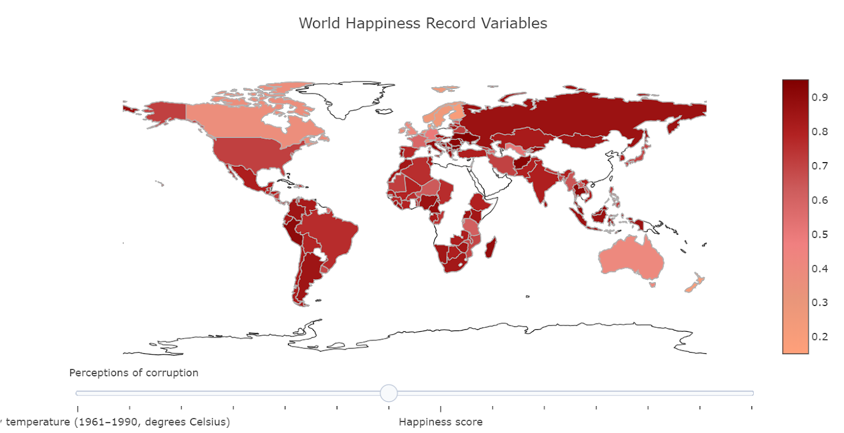
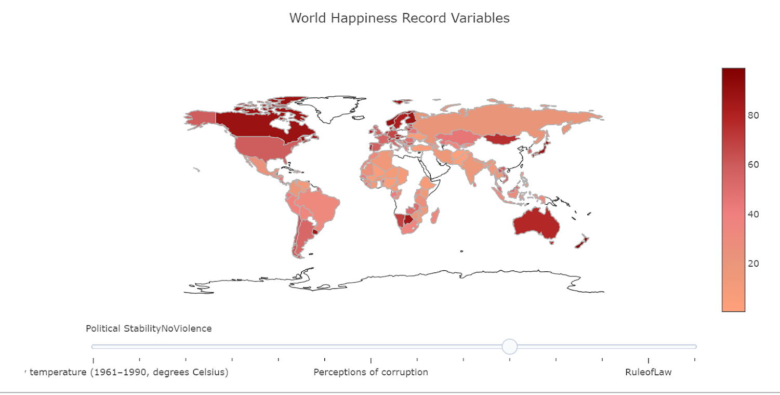
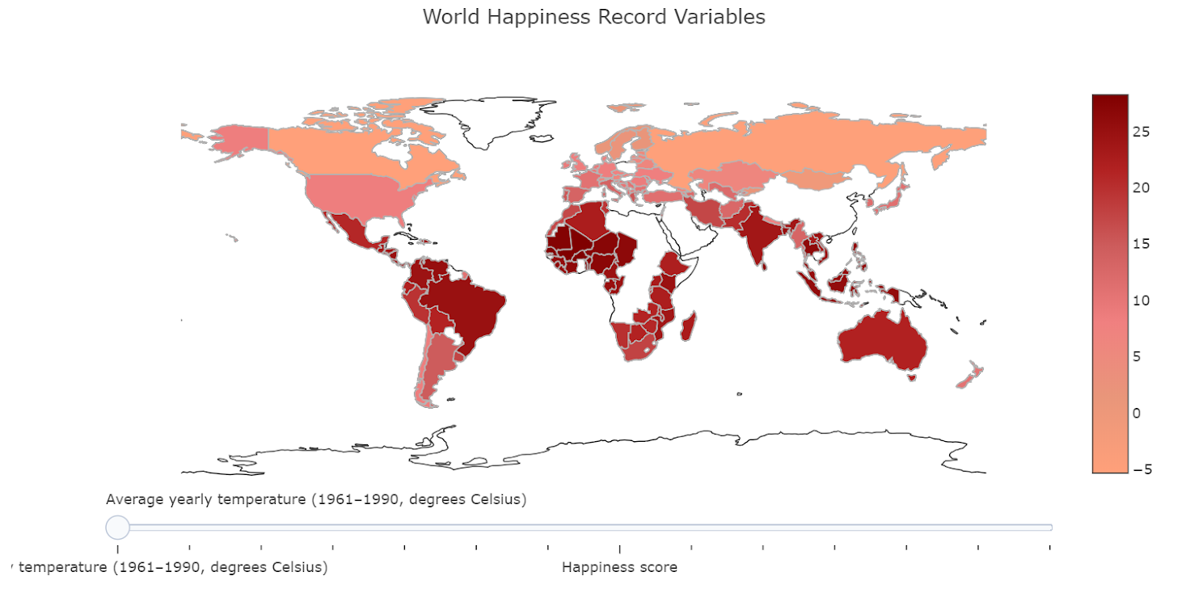
Choropleth
Notes:
World chloropleth map using plotly to show distribution of happiness scores and other variables around the world. Allows for easy visualisation. We also included a slider for the viewer to slide between variables.
Example: russia seems to have high perceptions of corruption as seen by the darker red regions in the world map.

Slide 8
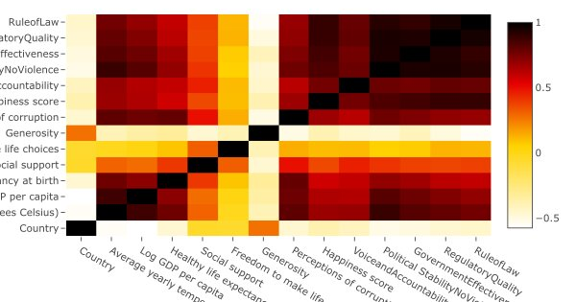

Multi-Variate Linear Regression
Correlation values between all pairs of variables
Notes:
We plotted a heatmap of the correlation values between all pairs of variables. From the heatmap, we can see that the governance factors have significant correlation with each other, as seen by the darker red region in the heatmap. Hence, we decided to use multivariate linear regression using the 6 governance factors.

Slide 9
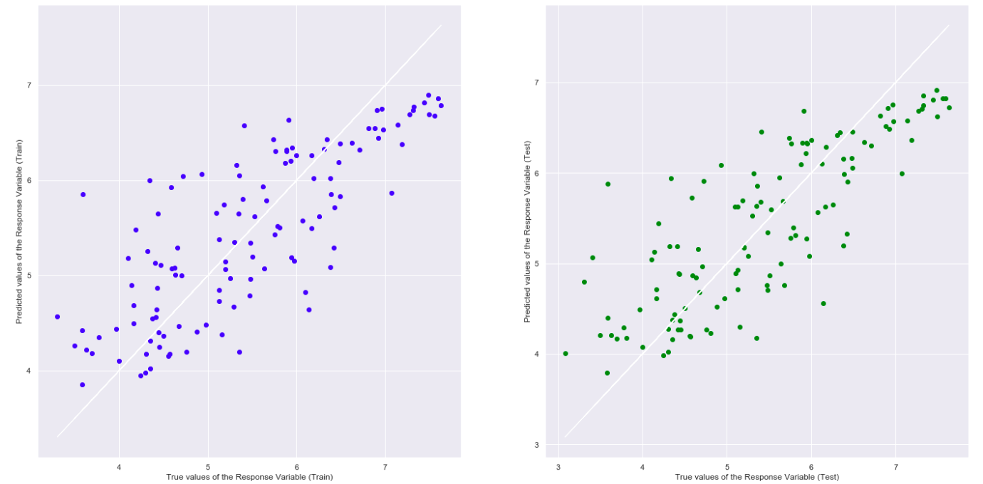
Multi-Variate Linear Regression - Governance
Explained Variance (R^2) on Train Set : 0.6220641736729298
Explained Variance (R^2) on Test Set : 0.6575144630799968
Notes:
This is the scatter plot of the train and test set obtained from the multi variate linear regression, and the R square value obtained is quite significant at 0.62 and 0.65 for the train and test set respectively.

Slide 10
Uni-Variate Linear Regression
Key variables supporting Happiness score (World Happiness Report):
Log GDP per capita (Income)
Healthy life expectancy at birth
Social support
Freedom to make life choices
Generosity
Perceptions of corruption
Notes:
Sherna:
Thank you Min Hui.
For uni-variate linear regression, we have chosen these 6 key variables in the World Happiness Report that supports Happiness.

Slide 11
Uni-Variate Linear Regression
External data:
Average yearly temperature (1961–1990)
Worldwide Governance Indicators (WGI)
Voice and Accountability
Political Stability and Absence of Violence
Government Effectiveness
Regulatory Quality
Rule of Law
Control of Corruption
Notes:
Sherna:
We also used external data such as:
Average yearly temperature (1961–1990)
Worldwide Governance Indicators (WGI)

Slide 12
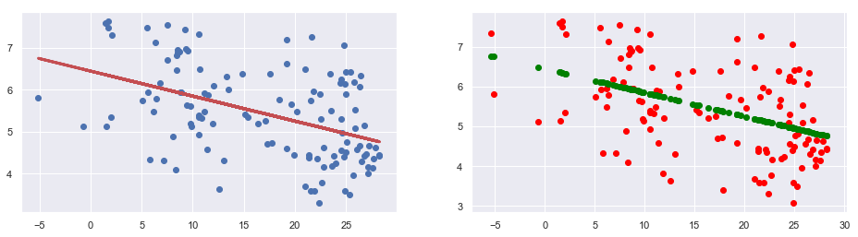
Happiness v. Average yearly temperature
Train = 1961-1990
Test = 2016
Average yearly temperature
R² on Train Set : 0.20929669609522028
R²on Test Set : 0.2230921821841516
Notes:
Sherna:
We performed linear regression on Happiness using Average yearly temperature and this is the result.

Slide 13
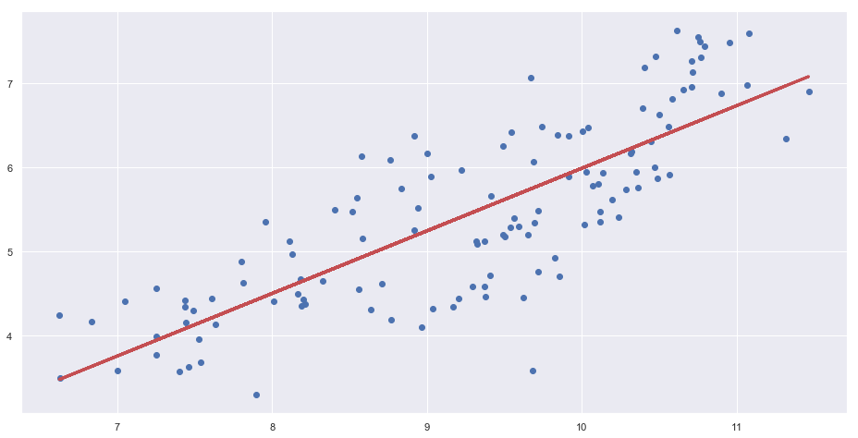
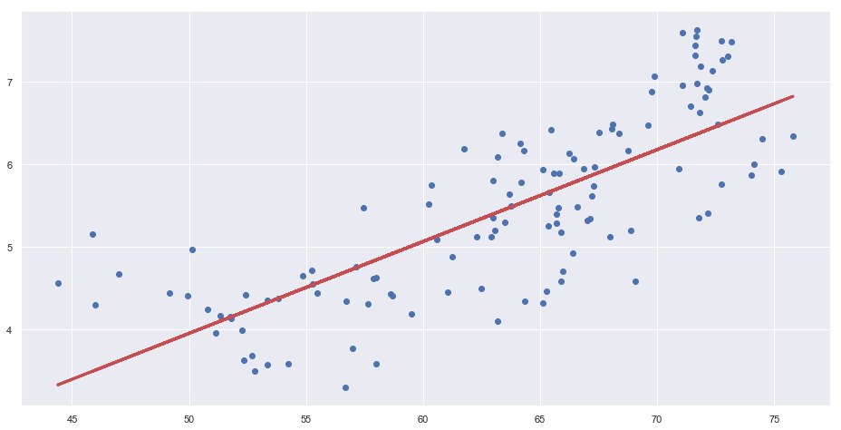
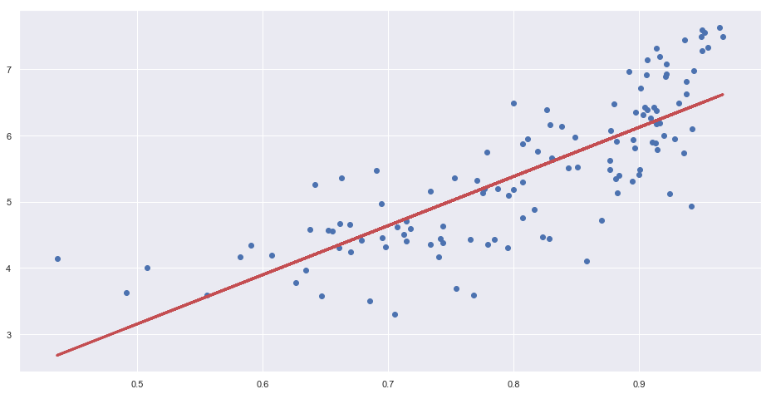
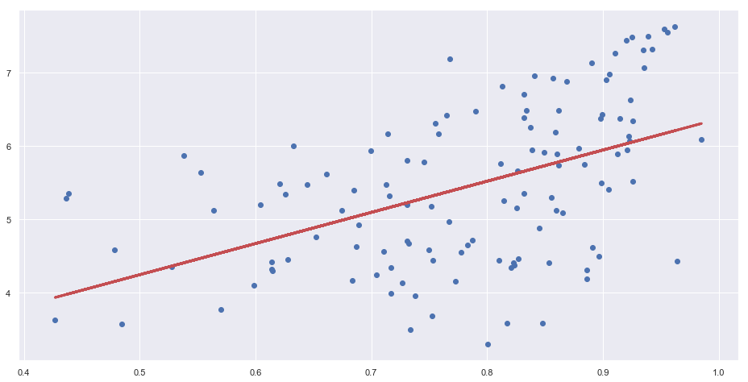
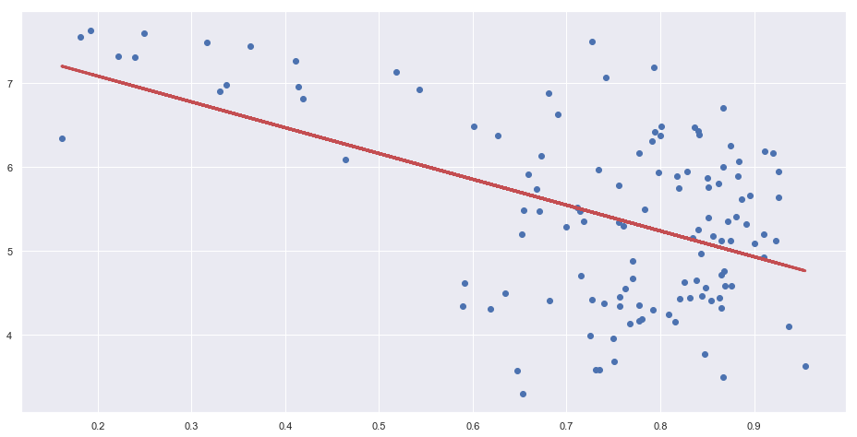
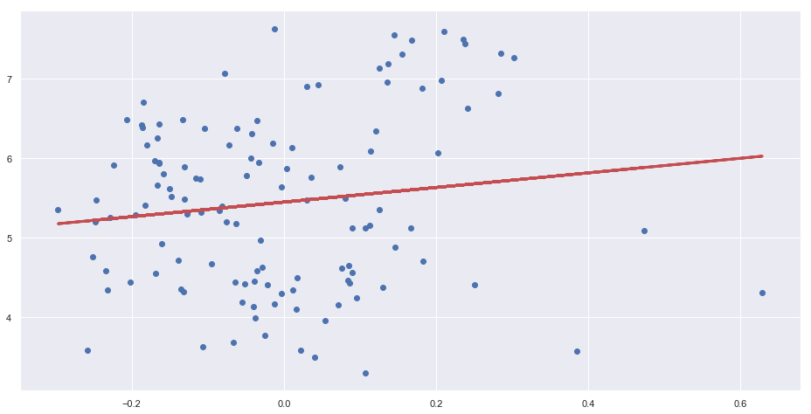
Happiness v. Predictors (Train = 2017)
Happiness v. Log GDP per capita
R² = 0.6479058891082845
Happiness v. Healthy life expectancy
R² = 0.6022419685730522
Happiness v. Social support
R² = 0.627718916165648
Happiness v. Freedom to make life choices
R² = 0.24505735861999367
Happiness v. Perceptions of corruption
R² = 0.25732825386416913
Happiness v. Generosity
R² = 0.01846282585409642
Notes:
Sherna:
We also performed linear regression on Happiness using the 6 key variables as the predictors and this is a summary of the train model.
We are using the 2017 dataset for training.

Slide 14
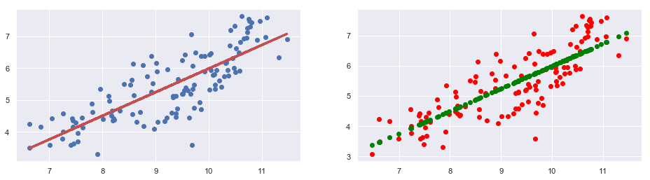
Happiness v. Log GDP Per Capita
Train = 2017
Test = 2016
Log GDP per capita
R² on Train Set : 0.6479058891082845
R² on Test Set : 0.6805431760666415
Notes:
Sherna:
For Happiness against GDP, the R² value is relatively high at 0.68 for the test set.

Slide 15
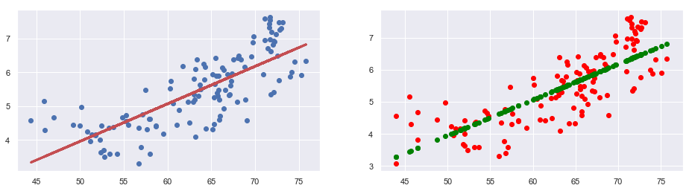
Happiness v. Healthy life expectancy
Train = 2017
Test = 2016
Healthy life expectancy at birth
R² on Train Set : 0.6022419685730522
R² on Test Set : 0.630794768528383
Notes:
Sherna:
For Happiness against Healthy life expectancy, the R² value is 0.63 for the test set.

Slide 16
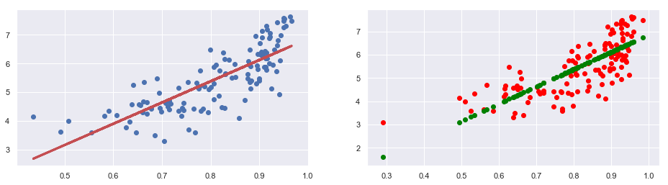
Happiness v. Social support
Train = 2017
Test = 2016
Social support
R² on Train Set : 0.6277189161656478
R² on Test Set : 0.5471991187450883
Notes:
Sherna:
For Happiness against Social support, the R² value is 0.54 for the test set, which is even lower.

Slide 17
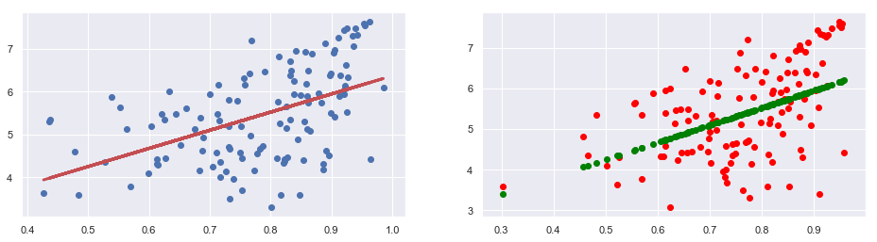
Happiness v. Freedom to make life choices
Train = 2017
Test = 2016
Freedom to make life choices
R² on Train Set : 0.24505735861999367
R² on Test Set : 0.2509845810863077
Notes:
Sherna:
For Happiness against Freedom to make life choices, the R² value is relatively low at 0.25 for the test set.

Slide 18
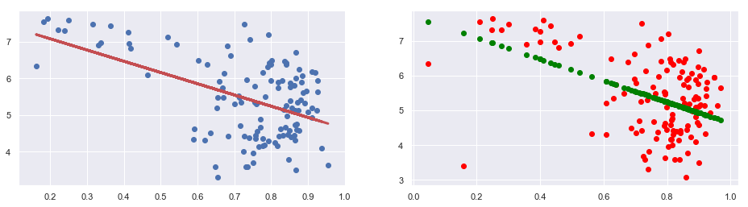
Happiness v. Perceptions of corruption
Train = 2017
Test = 2016
Perceptions of corruption
R² on Train Set : 0.25732825386416913
R² on Test Set : 0.18688218095350628
Notes:
Sherna:
For Happiness against Perceptions of corruption, the R² value is 0.18 for the test set, which is even lower.

Slide 19
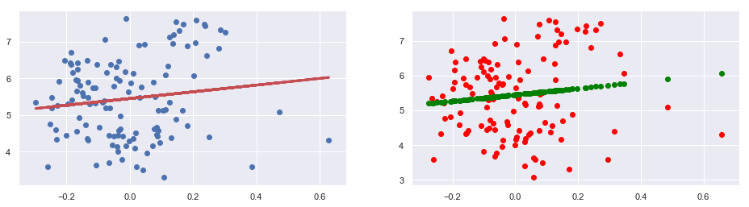
Happiness v. Generosity
Train = 2017
Test = 2016
Generosity
R² on Train Set : 0.01846282585409642
R² on Test Set : 0.009496129672979081
Notes:
Sherna:
For Happiness against Generosity, the R² value is 0.009.

Slide 20
Happiness v. Predictors (Train = 2017)
Log GDP per capita
R² = 0.647
Social support
R² = 0.627
Governance
R² = 0.622
Healthy life expectancy
R² = 0.602
Freedom
R² = 0.245
Perceptions of corruption
R² = 0.257
Generosity
R² = 0.018
Notes:
Sherna:
So this is a summary of the R² values for all the predictors.
In the top row, we can see that these 4 predictors have similar high R^2 values of around 0.6.
In the bottom row are the 3 predictors that yields lower R² value.
The predictor that outputs the highest R^2 value is GDP.
Conversely, Generosity yields the lowest R^2 value.
We know that the higher the R^2 value, the better the Linear Regression model.
Thus, the 4 predictors: GDP, Social support, Governance and Healthy LE qualifies as good predictors of Happiness.
For the remaining 3 predictors: Freedom, Corruption & Generosity, there could be 2 possible cases that answers why it has a low R^2 value:
It could be there is no strong correlation between happiness & the predictor
Or the Correlation is not linear

Slide 21
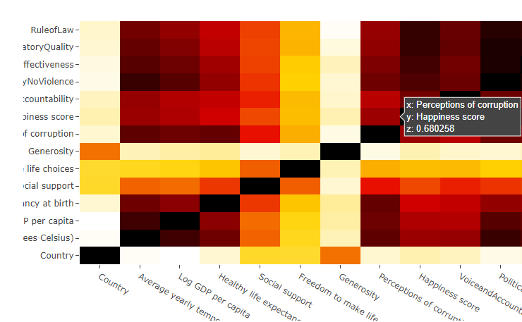
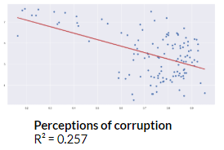
Interesting observation
Notes:
Sherna:
There is something interesting about Perceptions of corruption.
Even though it has a low R² value of 0.25, but it has a strong correlation of +0.68.
If we look at the graph, and we splitting it in half, we can see on the LHS, it seems linear. Whereas on the right, there seems to be no correlation.
This suggests that there is a correlation, but not well described by a linear relationship.
I will now hand over the time to Ezekiel for the next section.

Slide 22
Neural Network
Correlation only tells us which variable is more important
Does not actually help us predict country’s happiness score
Neural network helps with that
Notes:
Ezekiel:

Slide 23
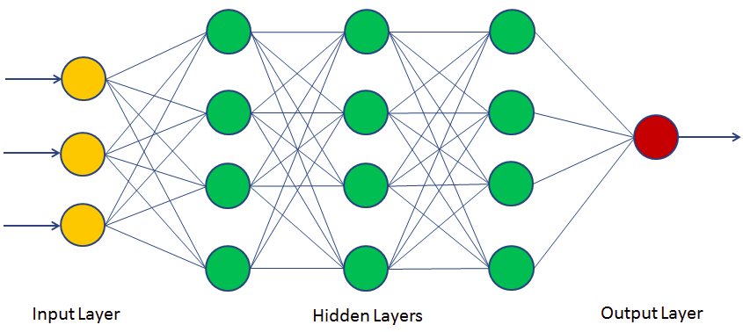
Neural Network
(13)
(13)
(13)
(13)
(1)
Scikit multi-layer perceptron
13 inputs, 1 output
3 hidden layers, 13 neurons each
Weights and biases adjusted with each iteration to minimise cost function (the lower, the better)
Trained with 2017 data
Notes:
Ezekiel:

Slide 24
Neural Network
Accuracy (mlp.score)
2013 | 2014 | 2015 | 2016 | 2017 | 2018*
76.5% | 78.6% | 80.5% | 84.4% | 85.3% | 83.8%
*No governance data available, 2017 used
Sample predictions
Country and year | Actual | Predicted | Error
AFG 2017 | 3.6315 | 3.7190 | 2.41%
SWE 2017 | 7.3144 | 7.5448 | 3.15%
SIN 2016 | 6.3432 | 6.0019 | -5.38%
CHE 2015 | 7.4872 | 7.3601 | -1.70%
Notes:
Ezekiel:

Slide 25
Conclusion
Happiness can be predicted to a significant, usable extent
What is the most significant variable used in predicting happiness?
Log GDP per capita (how much money there is)
Followed by social support, governance (how the money is used)
Then healthy life expectancy (effects of good use of money)
How accurately can we predict happiness using neural network?
At least 75% accuracy, broadly speaking
~5% error or less for prediction of individual country
The more recent the data, the better
Able to make predictions for speculative data/entirely fictional countries
Notes:
We conclude that this is the extent we can predict happiness to, given these variables, our limited knowledge and time. Ultimately, happiness is a very subjective and complex concept that cannot be defined by just a number and hence it is impossible to predict happiness with 100% accuracy.

Slide 26
Thank you!

Slide 27
Work Allocation
Cleaning of data done by: Sherna and Ezekiel
Data visualization done by: Min Hui
Linear Regression
Multi-variate done by: Min Hui
Uni-Variate done by: Sherna
Neural Network done by: Ezekiel
Compilation done by: Ezekiel
Conclusion from our analysis

Slide 28
References
Kaufmann, D., & Kraay, A. (2018). The Worldwide Governance Indicators (WGI) project. Retrieved April 9, 2019, from http://info.worldbank.org/governance/wgi/#home
List of countries by average yearly temperature. (2019, April 02). Retrieved April 9, 2019, from https://en.wikipedia.org/wiki/List_of_countries_by_average_yearly_temperature
World Happiness Report 2019. (20199, March 20). Retrieved April 9, 2019, from http://worldhappiness.report/ed/2019/
Carrington, D. (2015, October 21). Perfect temperature for economic success – 13C. Retrieved April 10, 2019, from https://www.theguardian.com/environment/2015/oct/21/perfect-temperature-for-economic-success-is-13c-climate-change

